Slide 1

Driver Drowsiness Detection System
MINOR PROJECT-2
AD-508
Problem Statement: Design and Development of Driver Drowsiness Detection System
Project Group Number: 4
Group Member Details: -
Harsh Singh Rajput (0187AD211017)
Mohit Sharma (0187AD211025)
Nazil Sheikh (0187AD211028)
Guide Details: Prof. Ruchi Jain

Slide 2






Idea/Approach Details
Abstract:-
Drowsiness Detection System Overview: Our project focuses on developing a real-time drowsiness detection system for drivers using deep learning technology. By leveraging convolutional neural networks (CNNs), we aim to analyze facial expressions and eye movements captured by an in-car camera to identify signs of driver drowsiness accurately.
Road Safety Enhancement: Through the deployment of our drowsiness detection system, we aspire to significantly reduce the risk of accidents caused by drowsy driving. By providing timely alerts and interventions, we aim to enhance road safety, prevent accidents, and save lives on our highways and roads.
Idea Solution :-
Utilize an in-car camera to capture real-time video footage of the driver's face.
Develop a deep learning model, specifically a convolutional neural network (CNN), trained on a dataset of drowsy and alert driving behaviors.
Deploy the CNN to analyze facial expressions and eye movements in real-time.
Trigger timely alerts, such as auditory alarms or visual warnings, upon detecting signs of drowsiness.
Implement intelligent interventions, like seat vibrations or voice prompts, to reawaken the driver and prevent accidents.
Technology stack:-

Slide 3
Project Requirements
Functional Requirements:-
Non Functional Requirements:-
Real-time Data Capture:
Capture live video of driver's face , Continuously stream data.
Drowsiness Detection:
Use deep learning for detection, Differentiate alert from drowsy states.
Alert Generation:
Issue timely alerts.
Performance:
Timely and accurate drowsiness detection , Resilience to environmental factors.
Reliability:
High accuracy with minimal false alarms.
Maintainability:
Modular design for easy updates.

Slide 4
Project Requirements
Hardware and Software Requirements:-
Hardware Requirements :
In-vehicle Camera
Computer System
Mounting Hardware
Power Supply
Display Unit (Optional)
Software Requirements :
Operating System
Deep Learning Framework
Computer Vision Library
Data Processing Tools

Slide 5
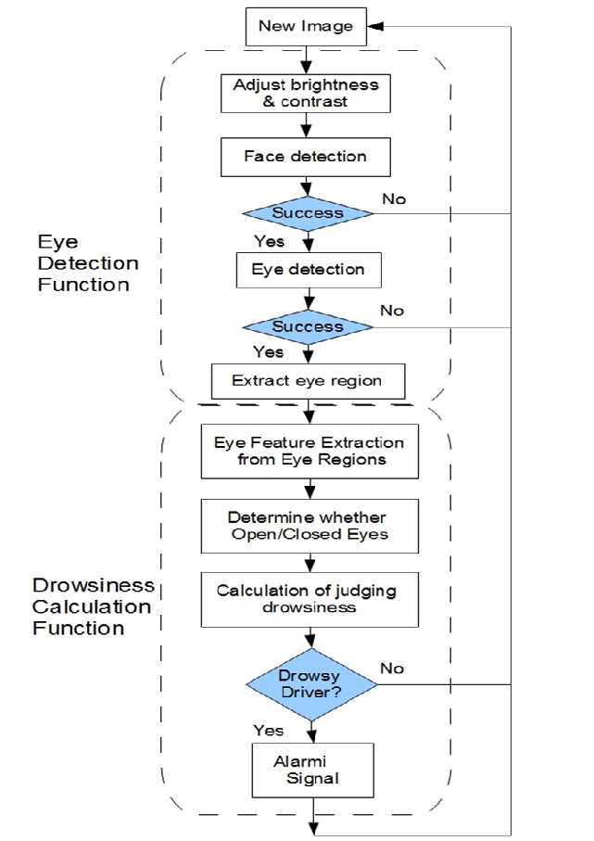
Design
Data Process Diagram:-

Slide 6
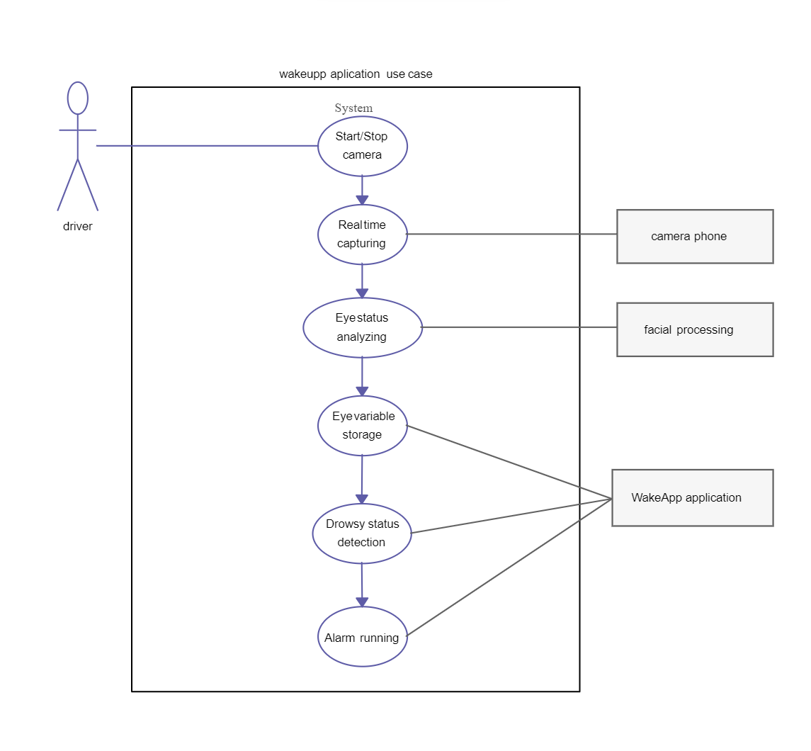
Design
Use Cases Diagram:-
Dependencies / Show stopper :-
Hardware: In-car camera, computer system.
Software: Operating system, deep learning framework.
Data: Dataset of drowsy and alert driving behaviors.
Networking (Optional): Network infrastructure.
External Integration: Vehicle systems compatibility.
Regulatory: Compliance with standards.
Power Supply: Reliable power source.

Slide 7
Deployment Details
Describe Deployment Details here:-
Hardware Setup: Connect Raspberry Pi and Camera Module.
OS Installation: Install Raspberry Pi OS.
Software Installation: Install Python, TensorFlow/PyTorch, OpenCV.
Model Deployment: Transfer trained model to Raspberry Pi.
Camera Integration: Write script for live video capture.
Testing: Ensure accuracy and calibration.
Mounting: Secure in-car installation.
User Training: Provide usage instructions.
Deployment: Install system in vehicle.
Maintenance: Regular checks and updates for optimal performance.

Slide 8


